Slide 1
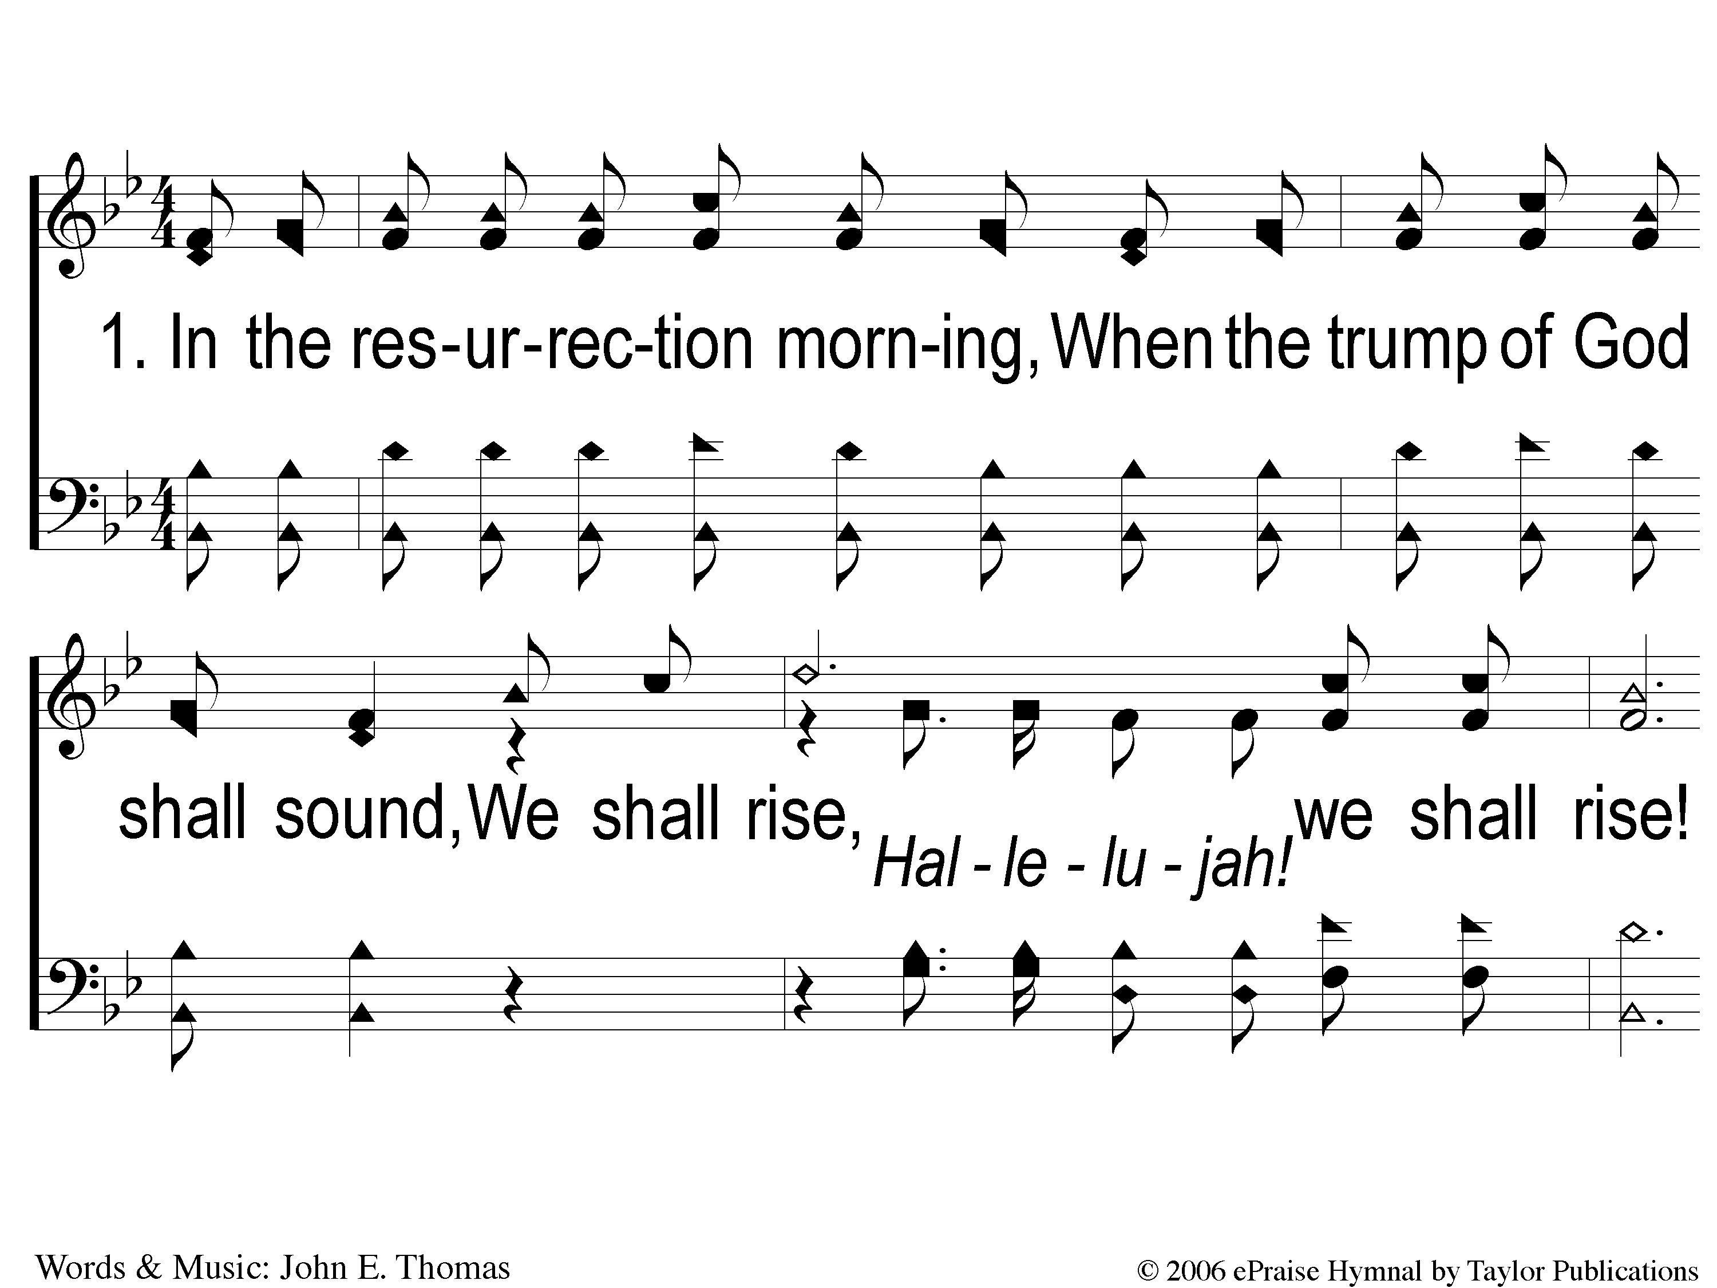
1-1 Hallelujah We Shall Rise
Hallelujah We Shall Rise
147

Slide 2
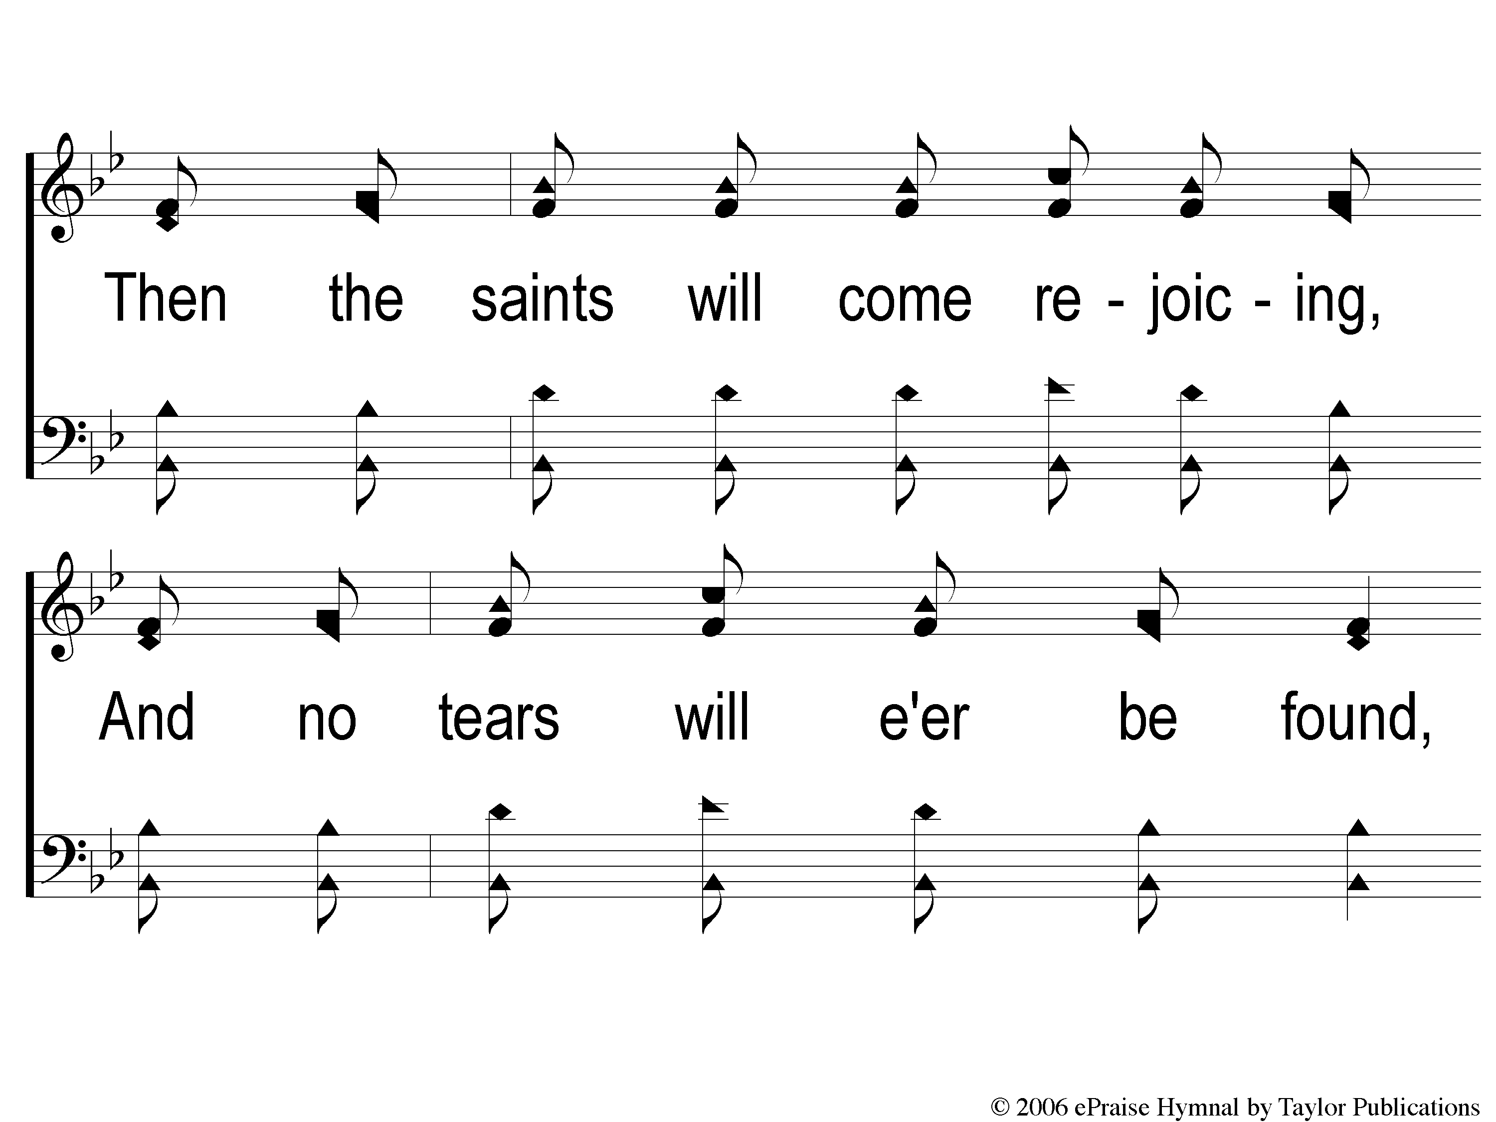
1-2 Hallelujah We Shall Rise
Hallelujah We Shall Rise
147

Slide 3
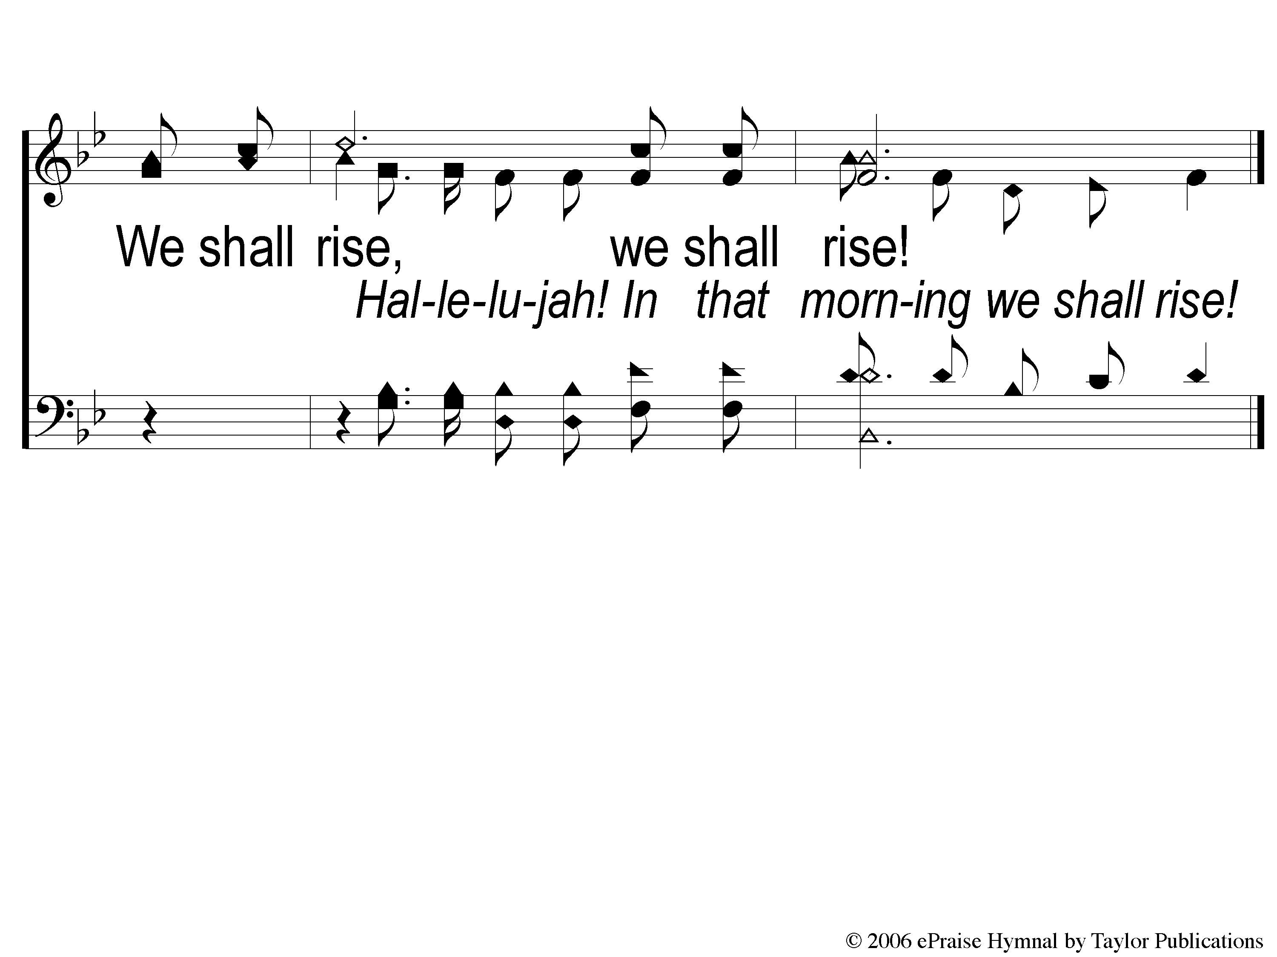
1-3 Hallelujah We Shall Rise
Hallelujah We Shall Rise
147

Slide 4
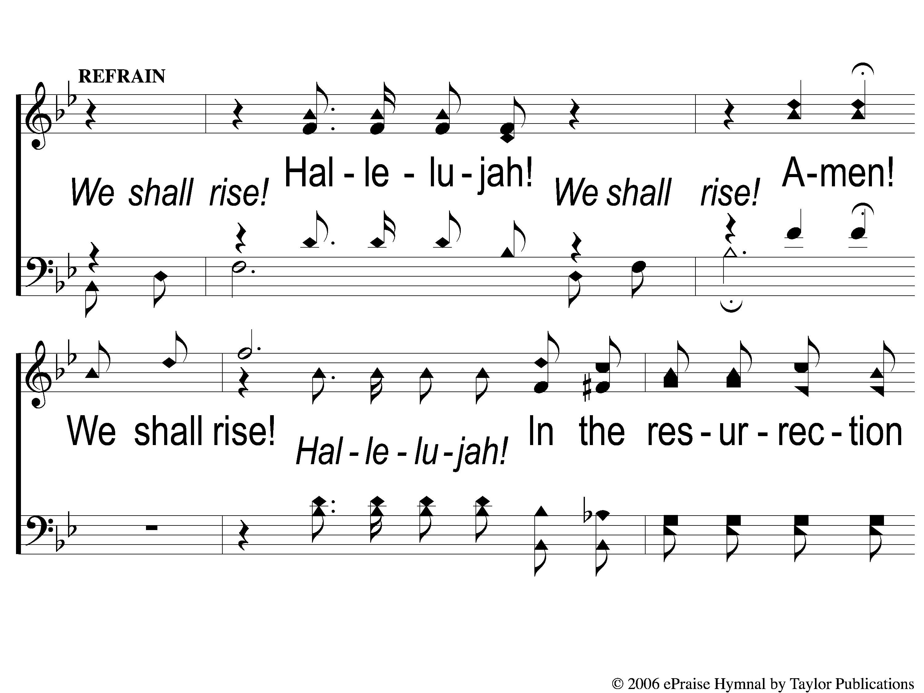
C-1 Hallelujah We Shall Rise
Hallelujah We Shall Rise
147

Slide 5
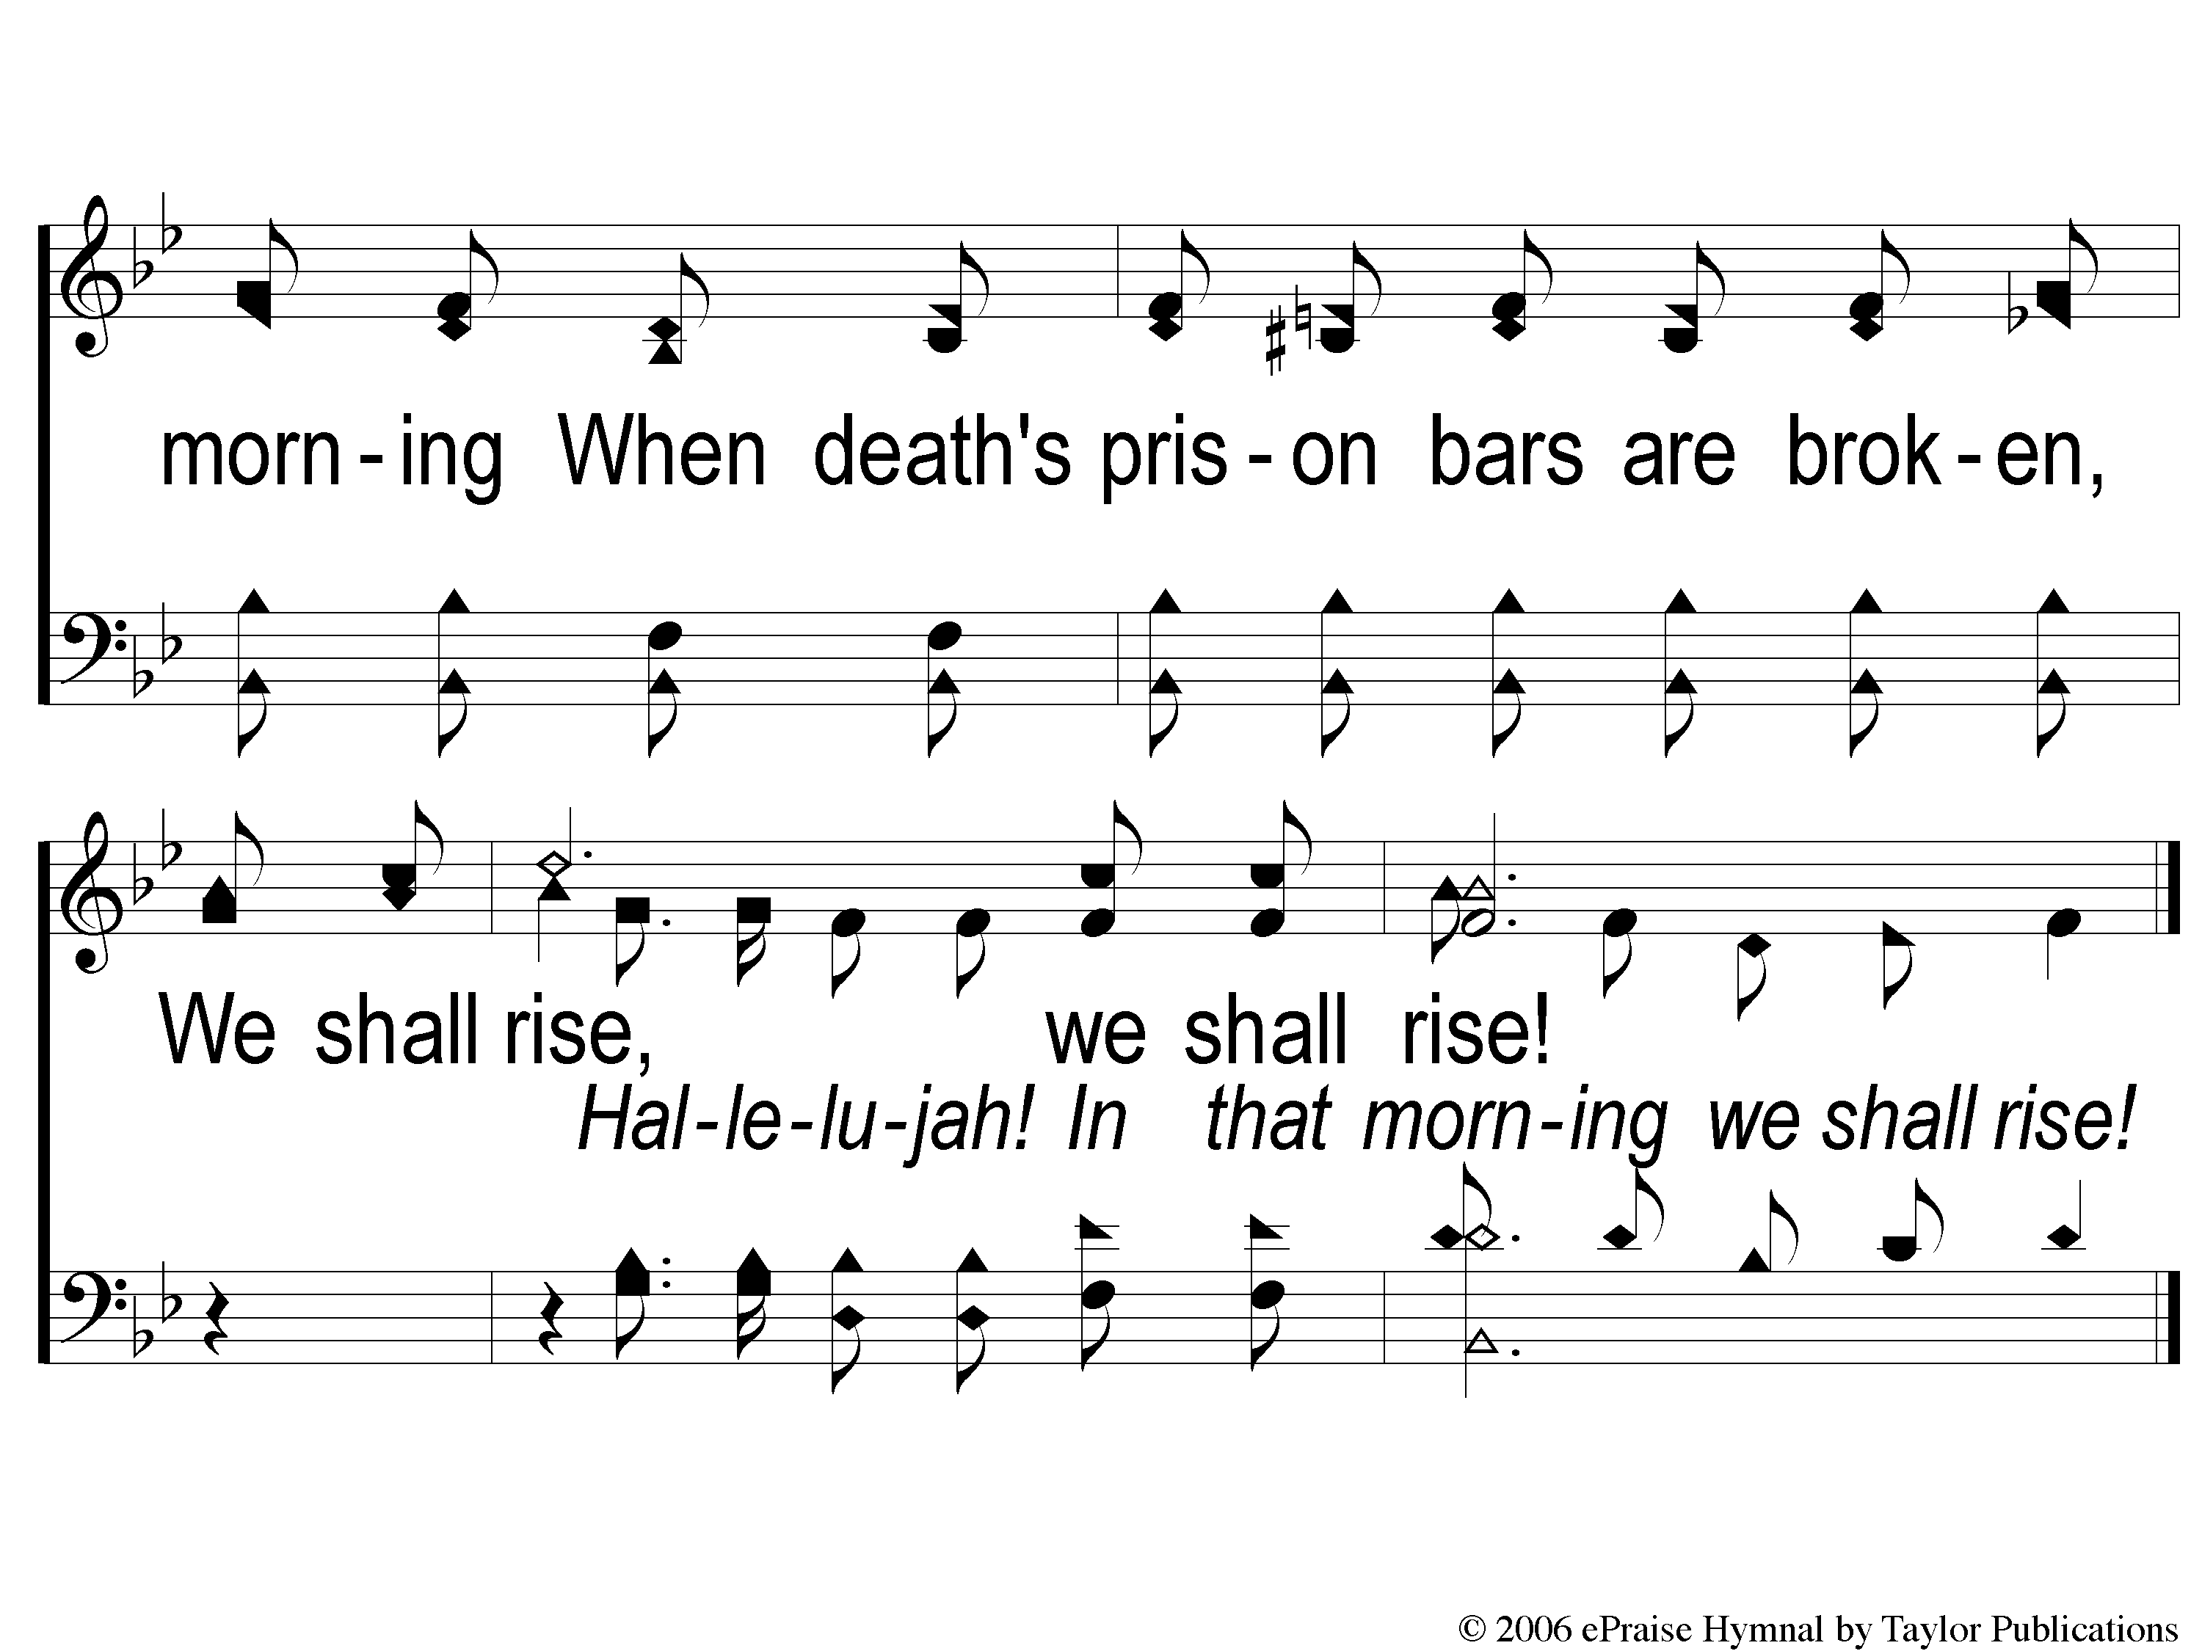
C-2 Hallelujah We Shall Rise
Hallelujah We Shall Rise
147

Slide 6
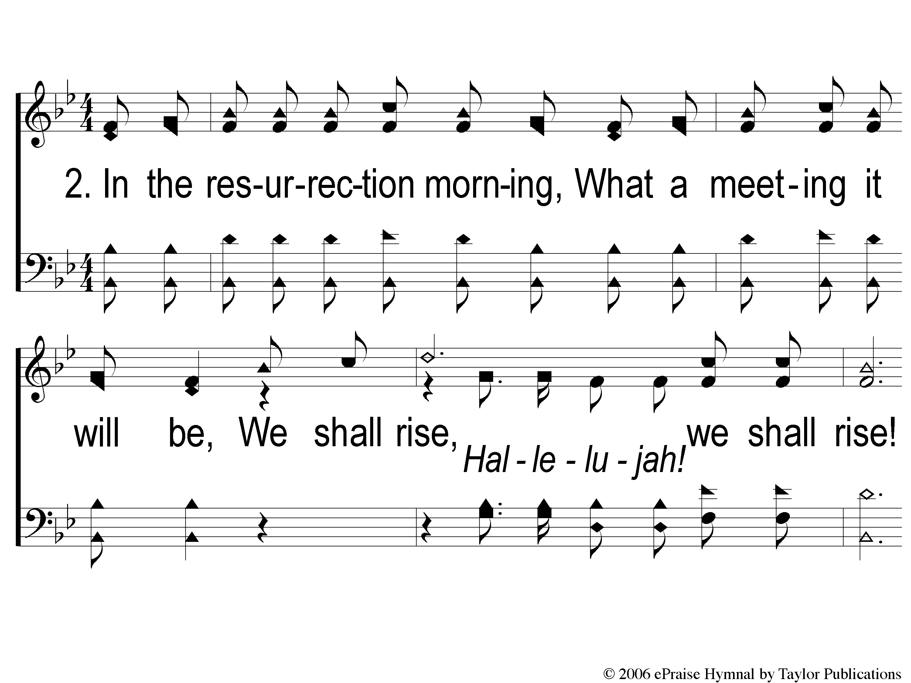
2-1 Hallelujah We Shall Rise
Hallelujah We Shall Rise
147

Slide 7
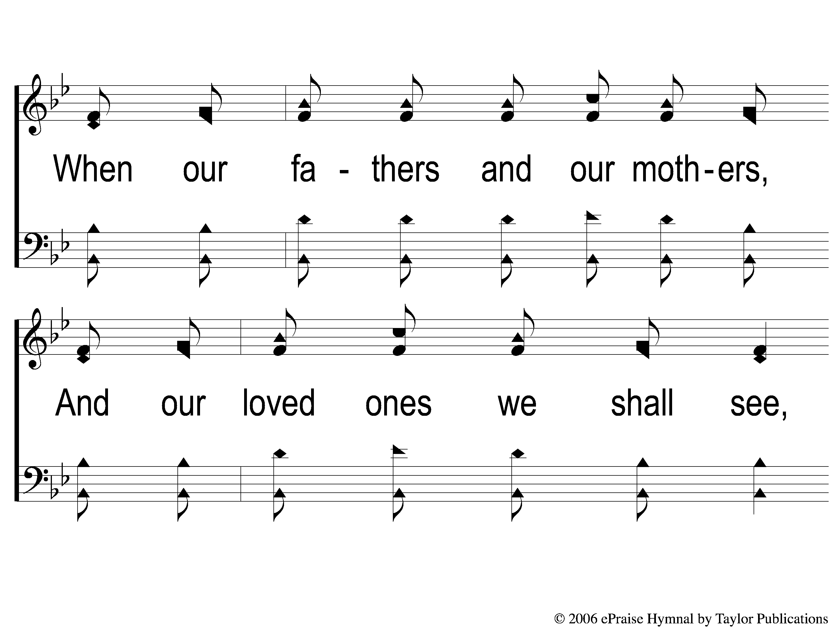
2-2 Hallelujah We Shall Rise
Hallelujah We Shall Rise
147

Slide 8
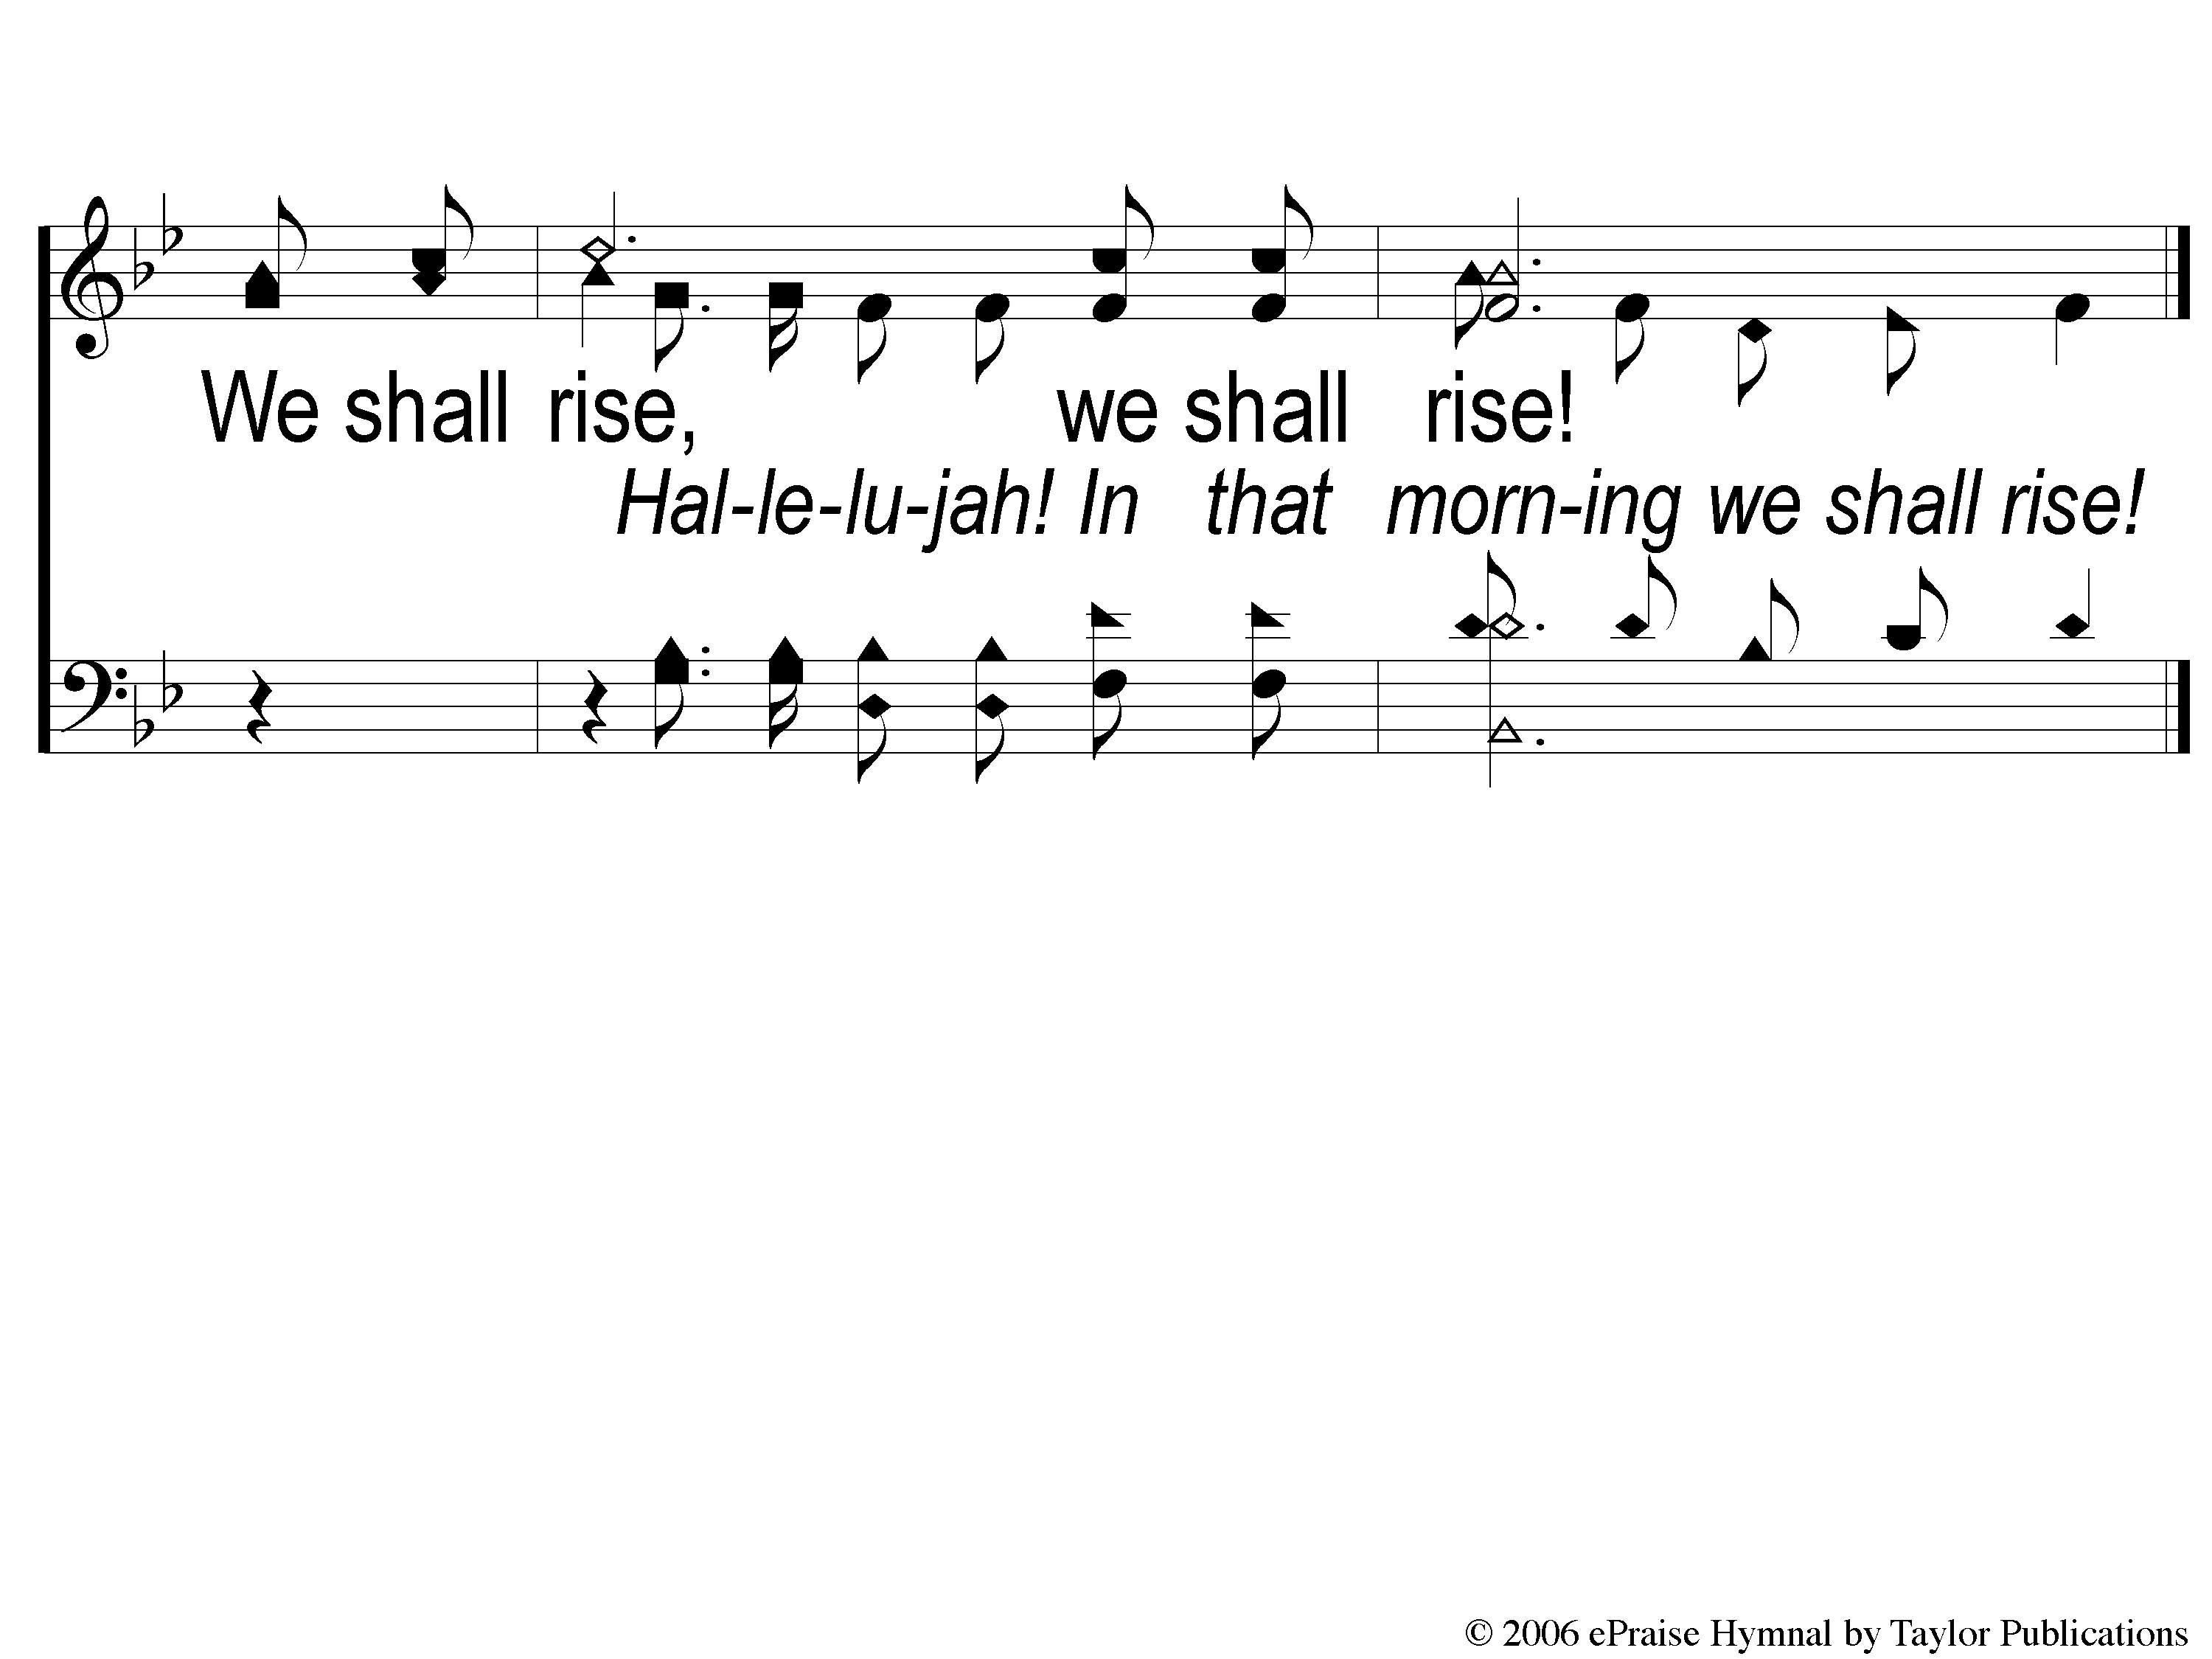
2-3 Hallelujah We Shall Rise
Hallelujah We Shall Rise
147

Slide 9
C-1 Hallelujah We Shall Rise
Hallelujah We Shall Rise
147

Slide 10
C-2 Hallelujah We Shall Rise
Hallelujah We Shall Rise
147

Slide 11
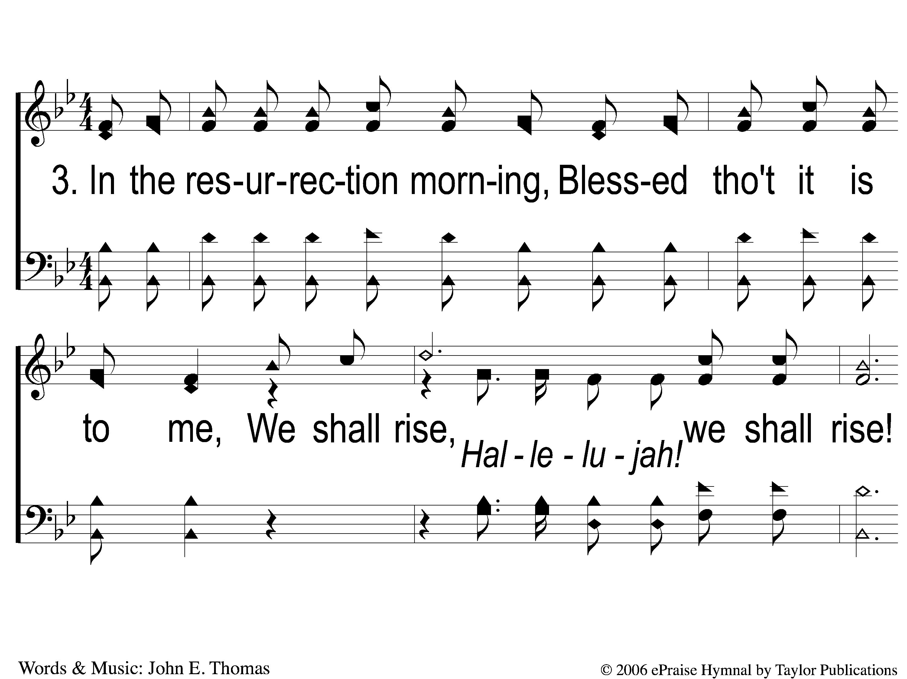
3-1 Hallelujah We Shall Rise
Hallelujah We Shall Rise
147

Slide 12
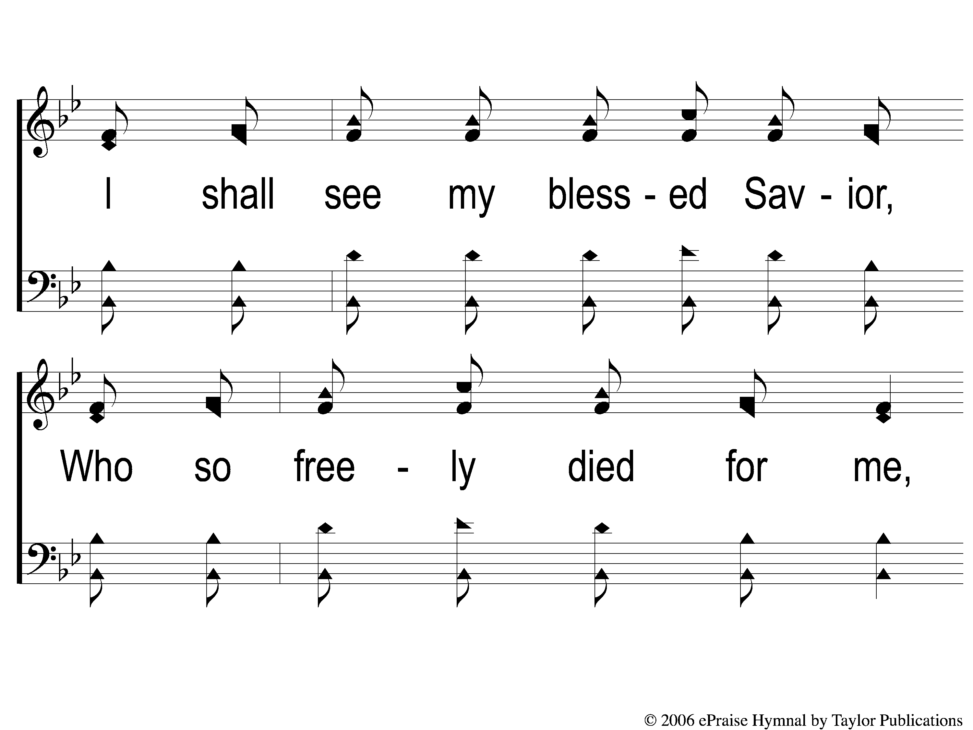
3-2 Hallelujah We Shall Rise
Hallelujah We Shall Rise
147

Slide 13

3-3 Hallelujah We Shall Rise
Hallelujah We Shall Rise
147

Slide 14
C-1 Hallelujah We Shall Rise
Hallelujah We Shall Rise
147

Slide 15
C-2 Hallelujah We Shall Rise
Hallelujah We Shall Rise
147

Slide 16
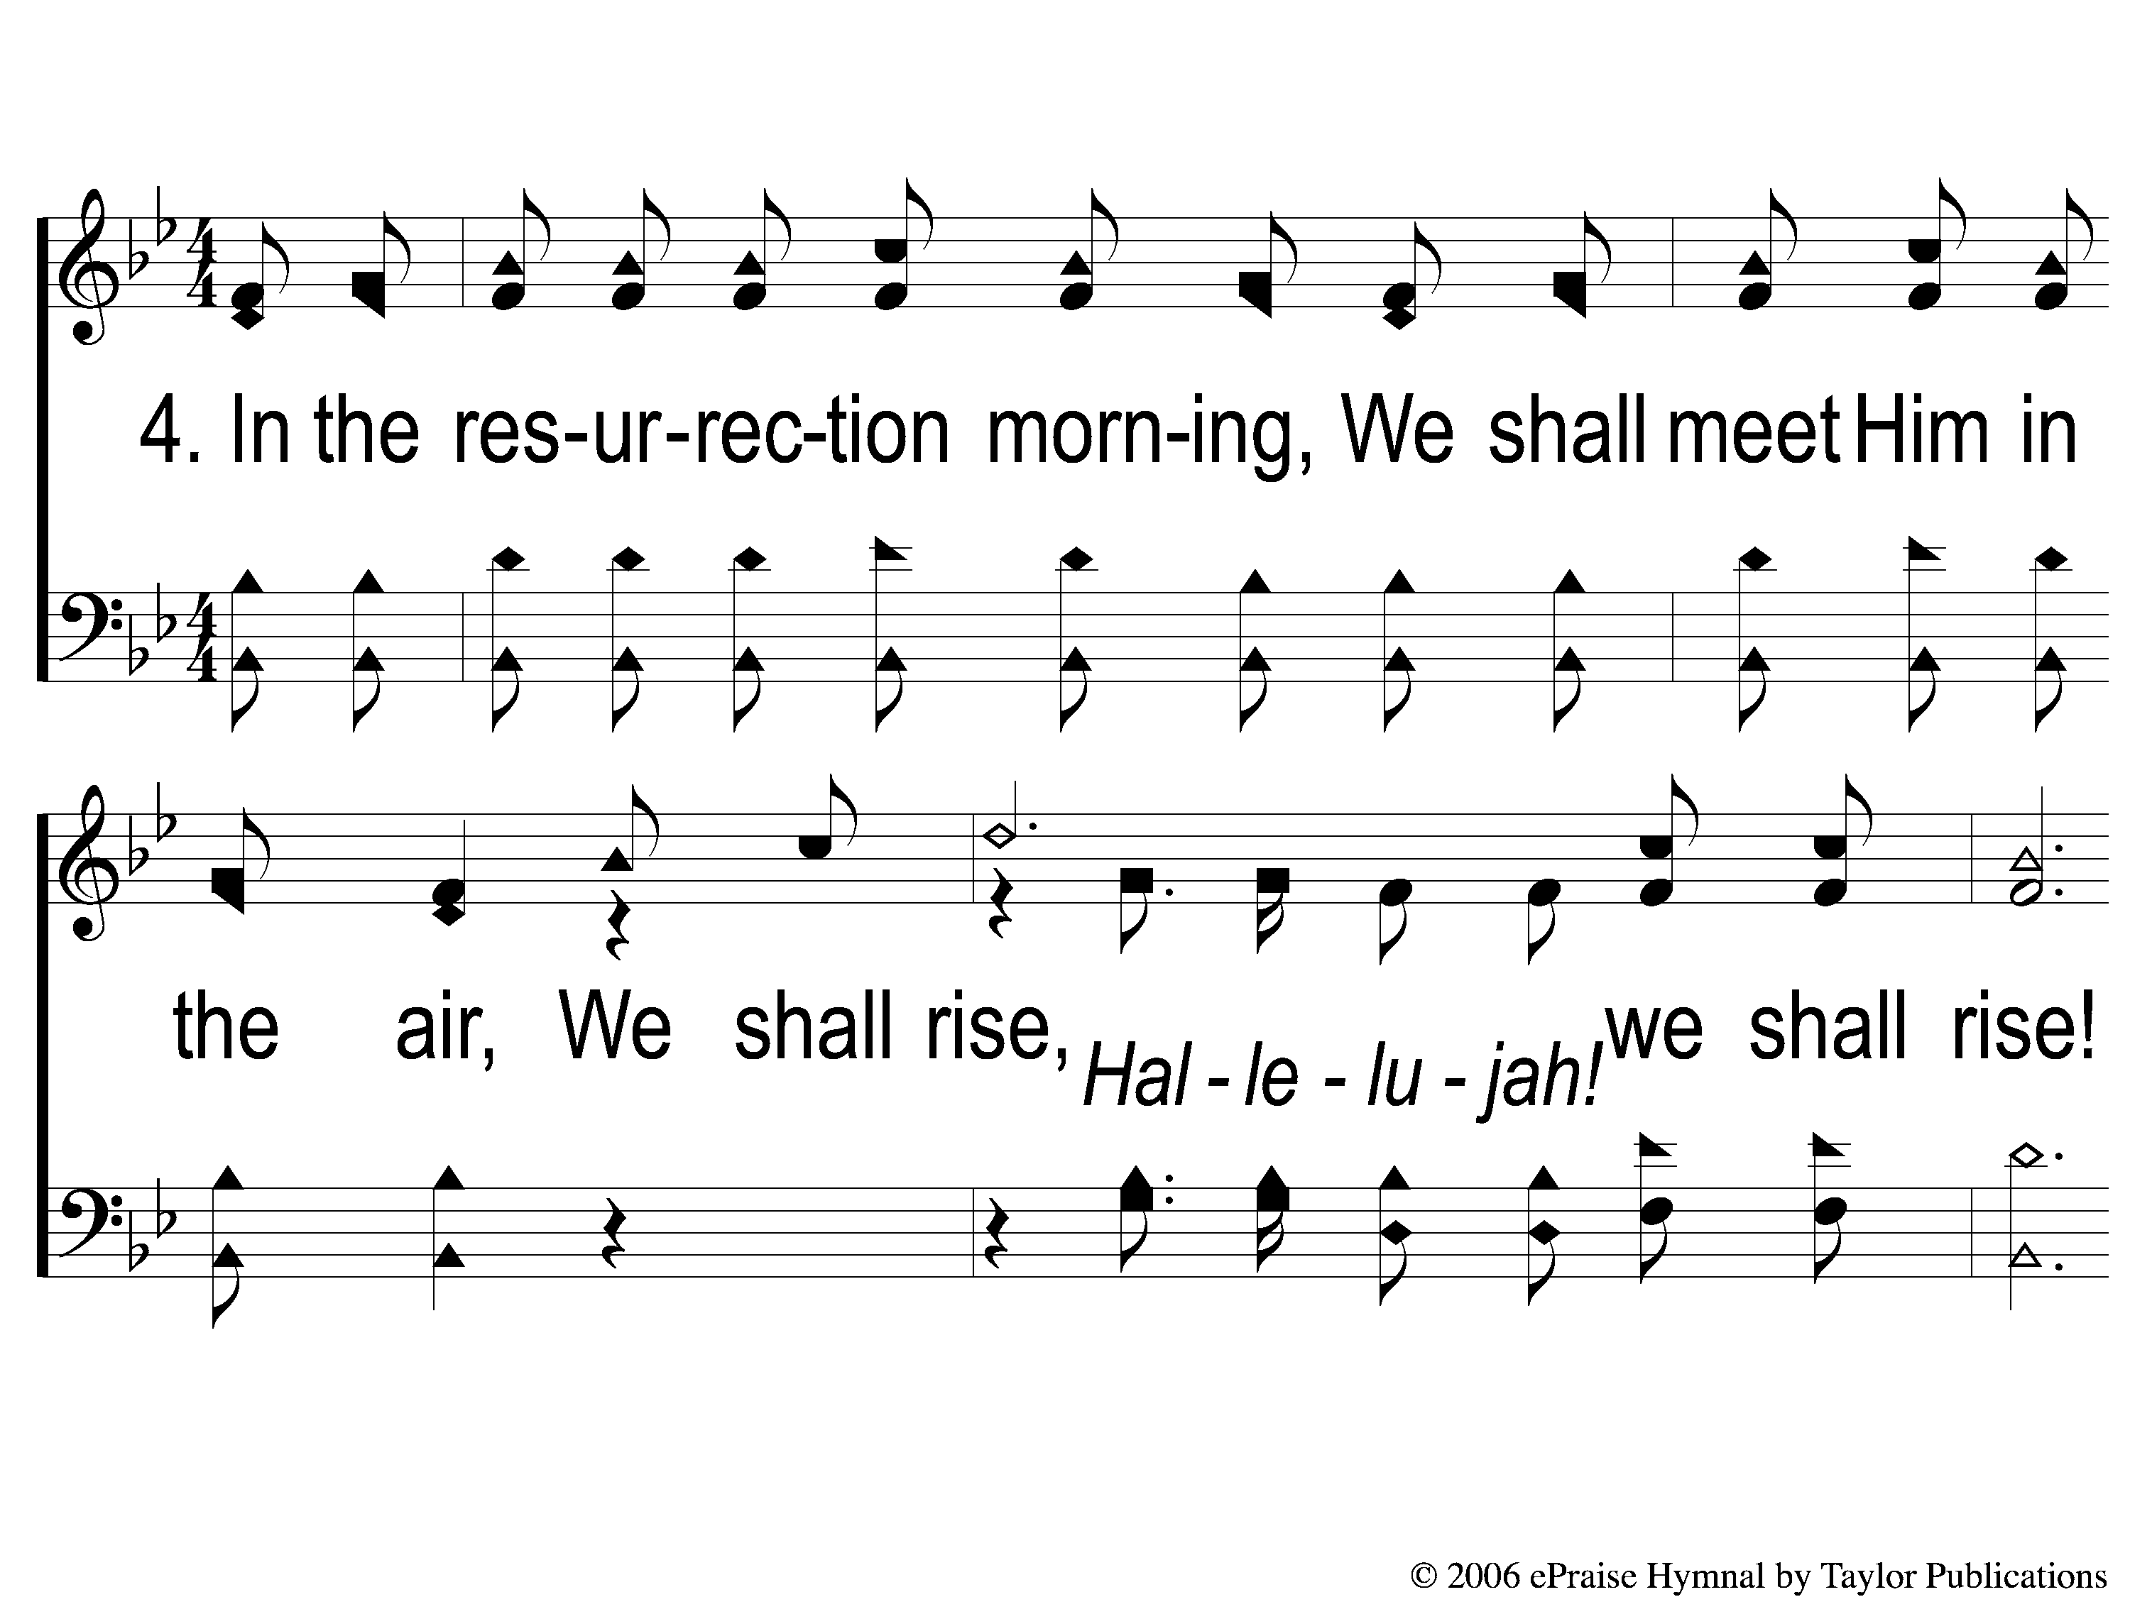
4-1 Hallelujah We Shall Rise
Hallelujah We Shall Rise
147

Slide 17
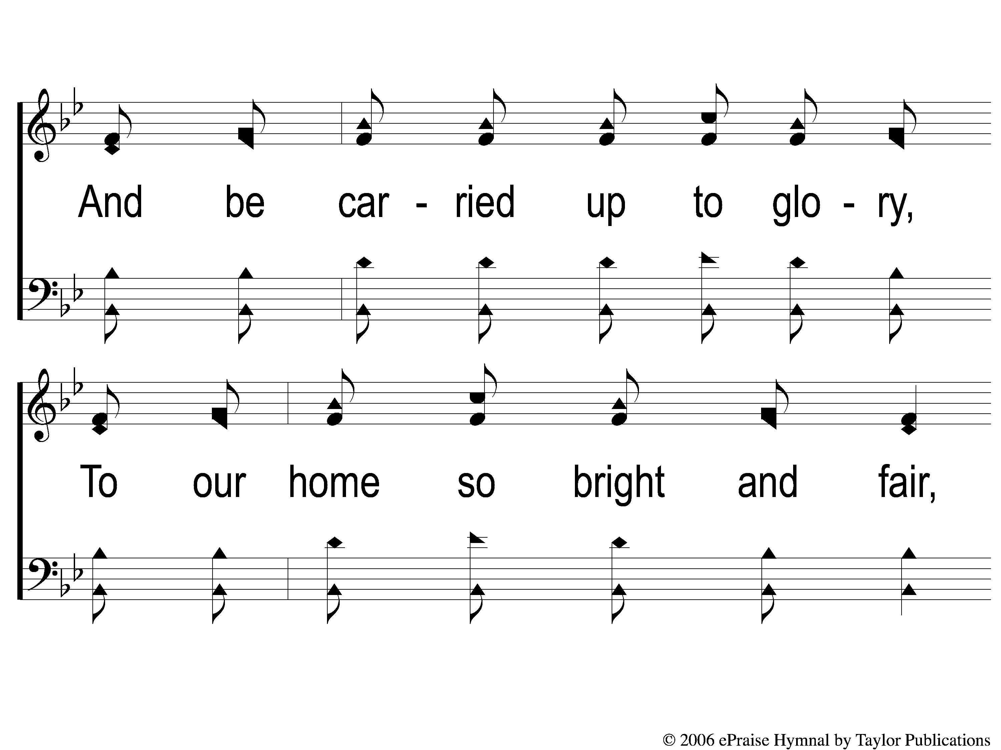
4-2 Hallelujah We Shall Rise
Hallelujah We Shall Rise
147

Slide 18
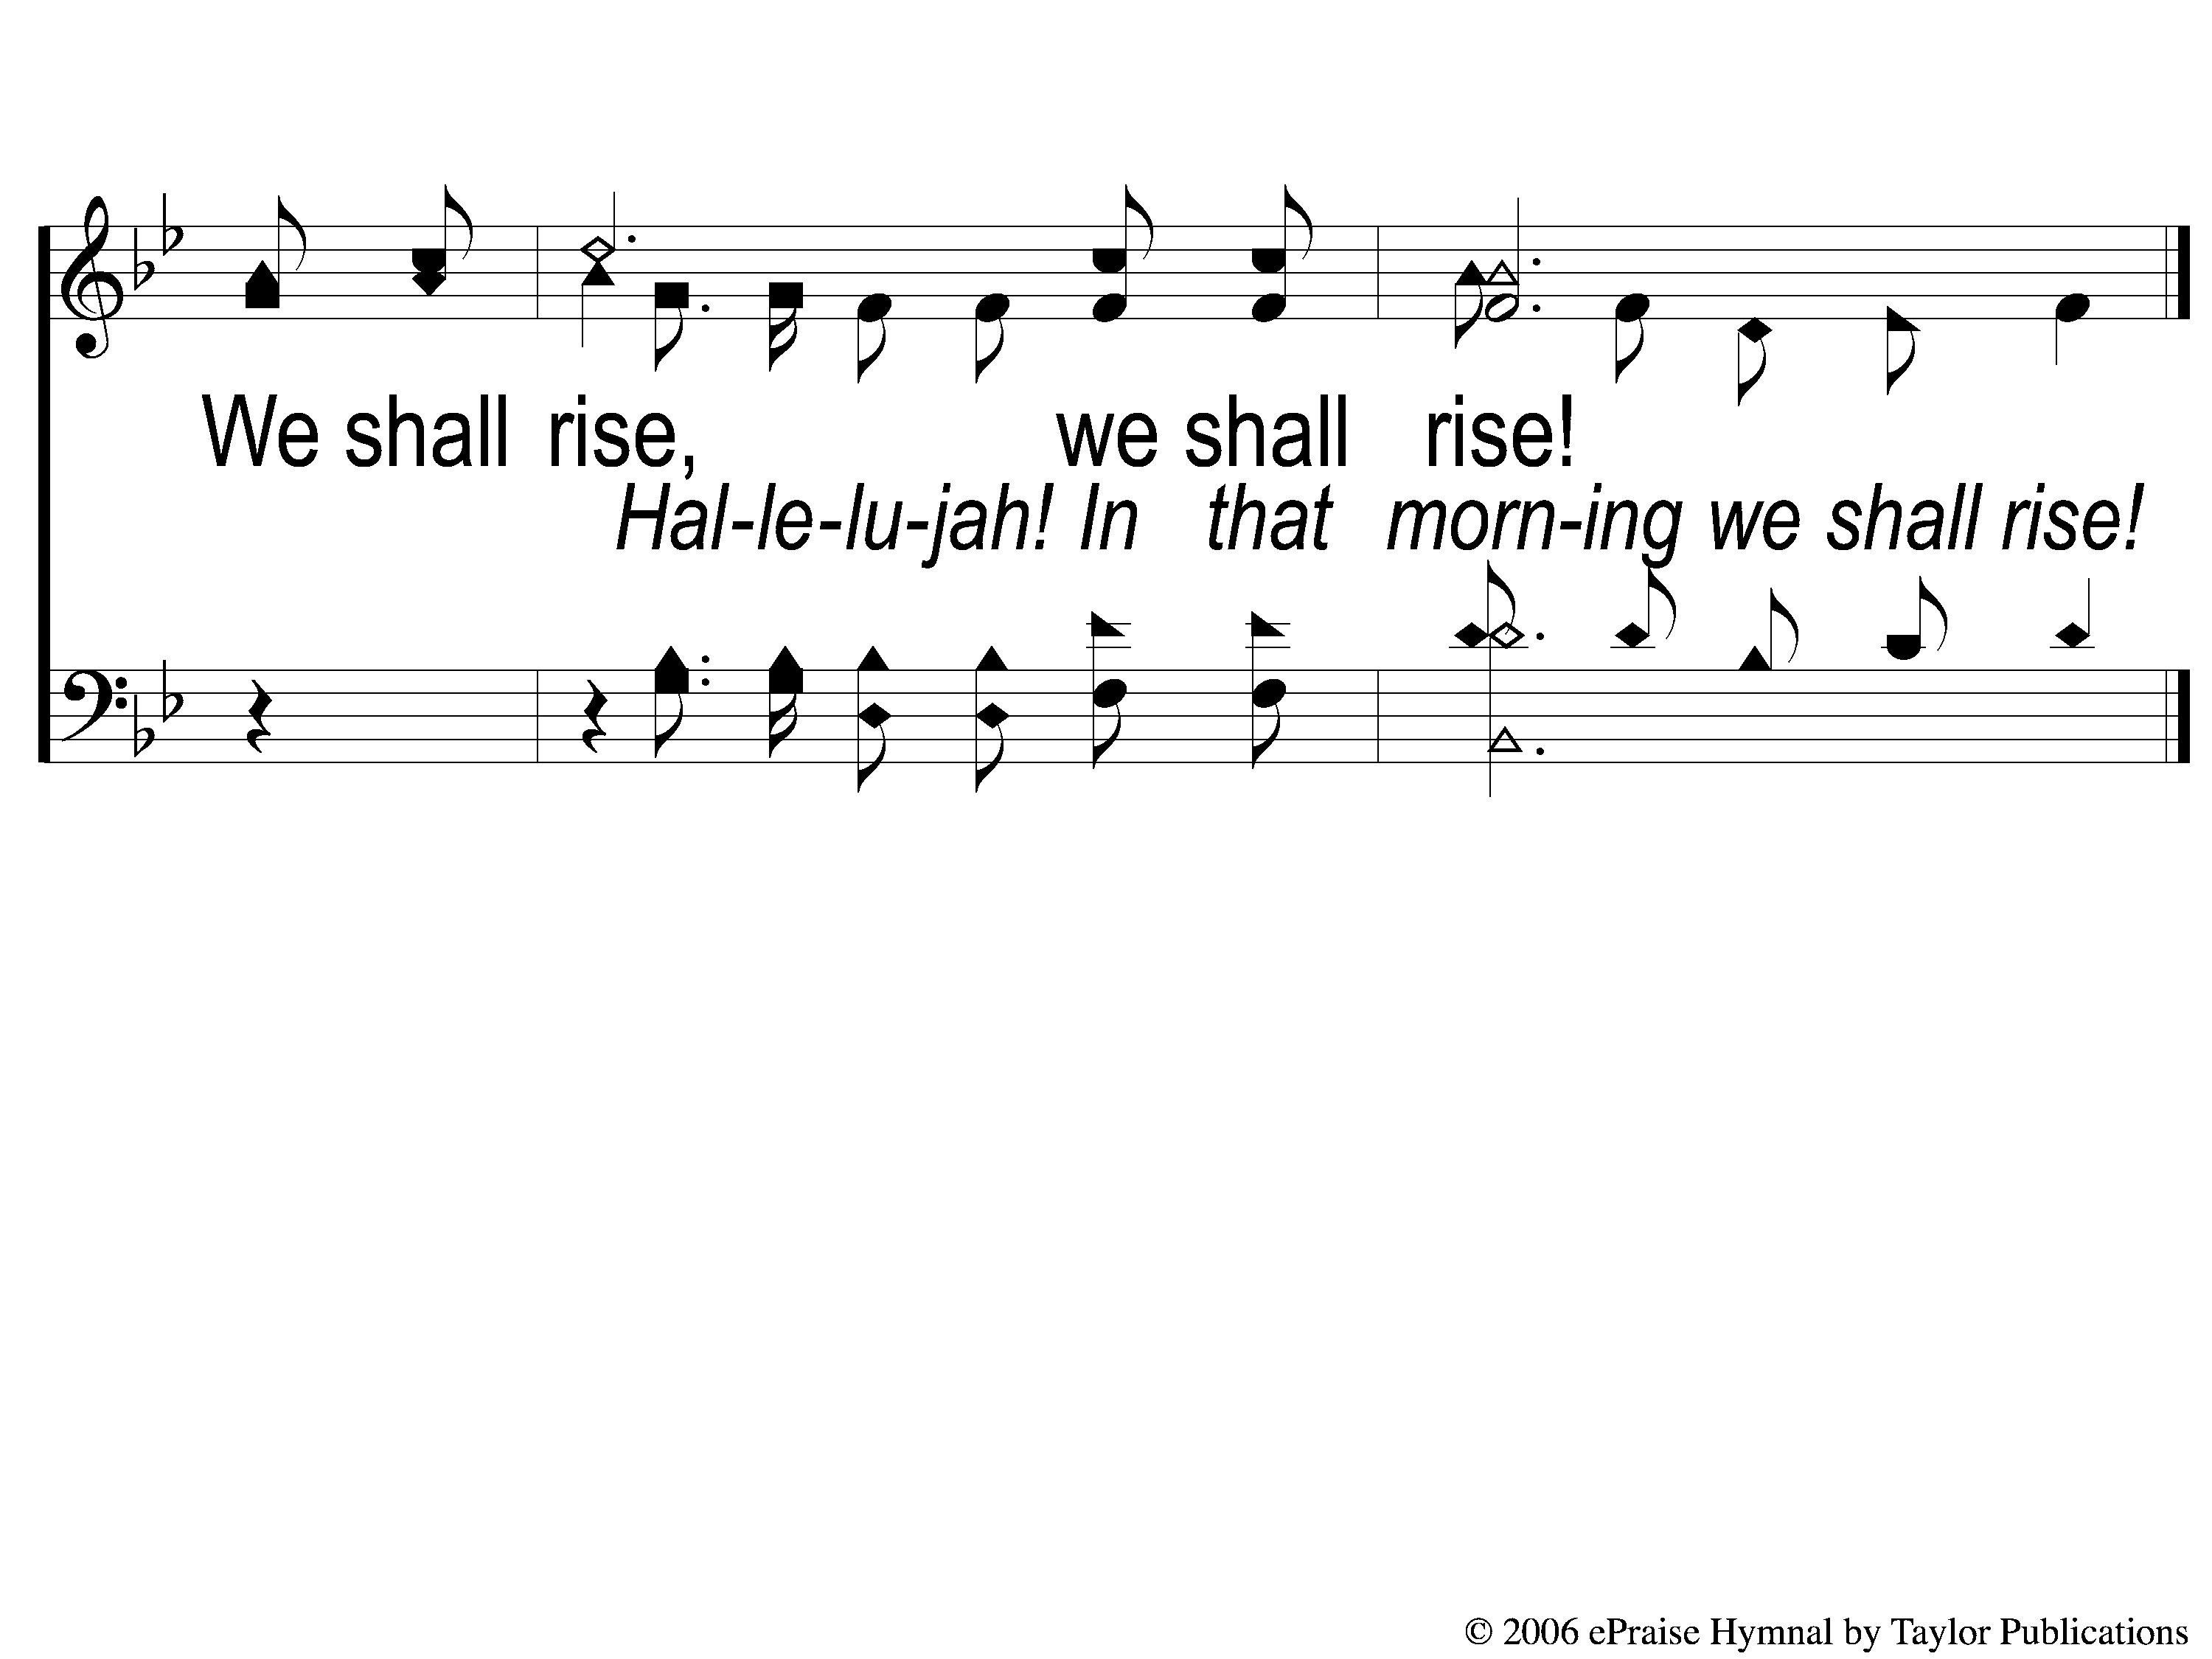
4-3 Hallelujah We Shall Rise
Hallelujah We Shall Rise
147

Slide 19
C-1 Hallelujah We Shall Rise
Hallelujah We Shall Rise
147

Slide 20
C-2 Hallelujah We Shall Rise
Hallelujah We Shall Rise
147

